Slide 1
3 D transformations

Slide 2
From 2D to 3D
Much +/- the same:
  Translation, scaling
  Homogeneous vectors: one extra coordinate
  Matrices: 4x4
Rotation more complex

Slide 3
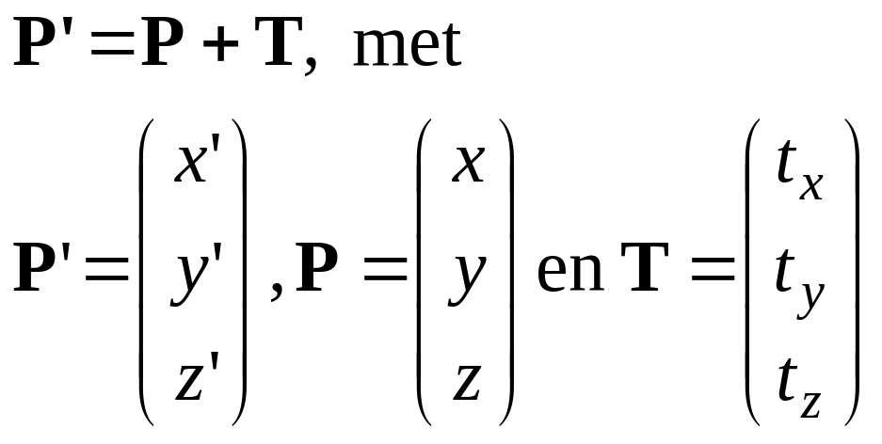
3D Translation 1
Translate over vector (t_{x}, t_{y,} t_{z} ):
x’=x+ t_{x}, y’=y+ t_{y} , z’=z+ t_{z}
or
y
P+T
T
P
x
z
H&B 9-1:304-305

Slide 4
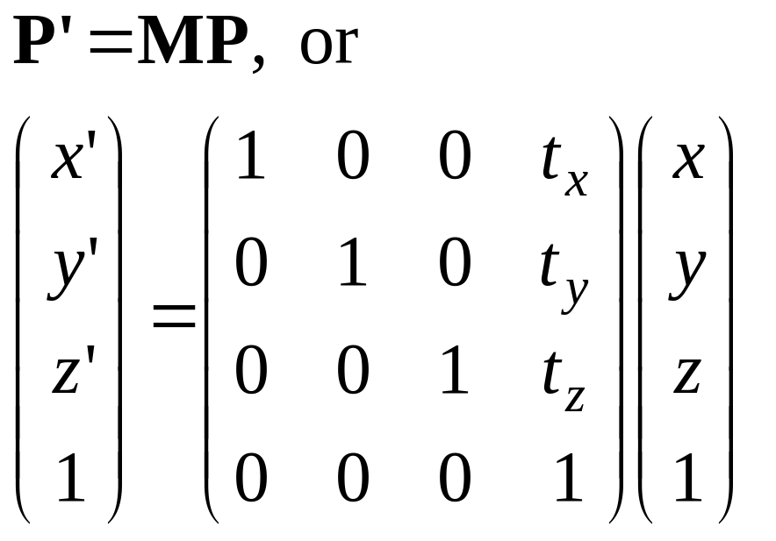
3D Translation 2
In 4D homogeneous coordinates:
y
P+T
T
P
x
z
H&B 9-1:304-305

Slide 5
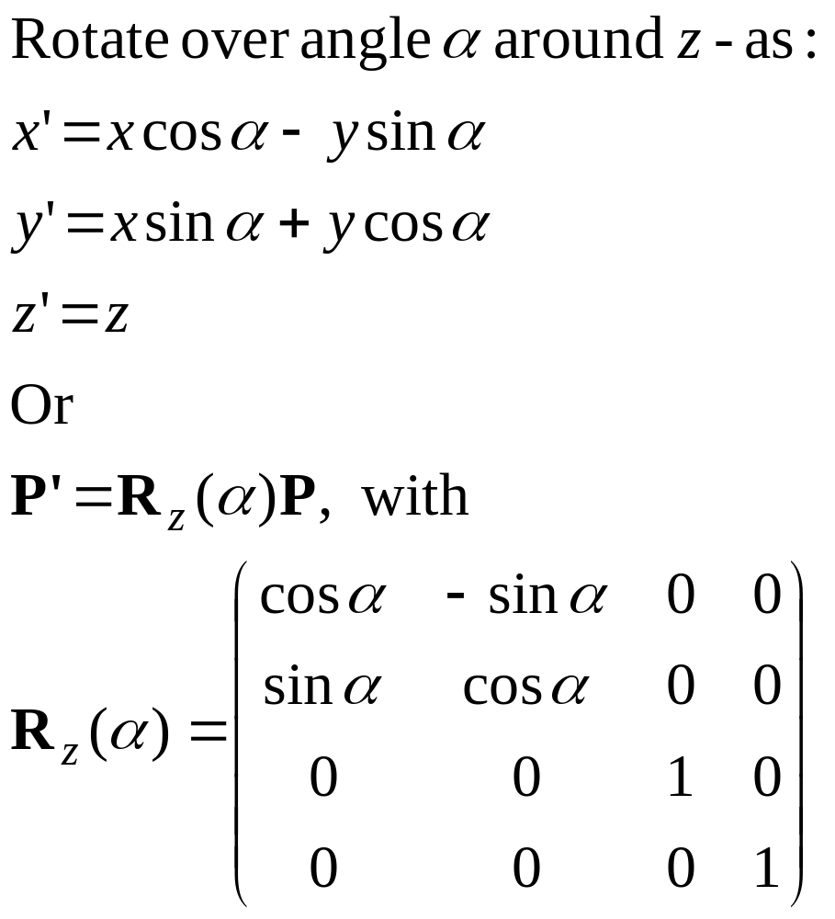
3D Rotation 1
z
y
P’
α
P
x
H&B 9-2:305-313

Slide 6
3D Rotation 2
z
y
z
y
z
y
x
x
x
Rotation around axis:
Counterclockwise, viewed from rotation axis
H&B 9-2:305-313

Slide 7
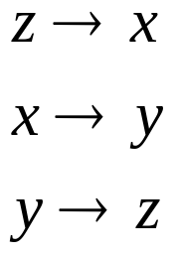
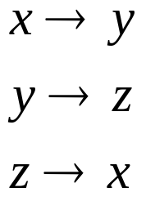

3D Rotation 3
z
z
y
z
y
y
x
x
x
Rotation around axes:
Cyclic permutation coordinate axes
H&B 9-2:305-313

Slide 8

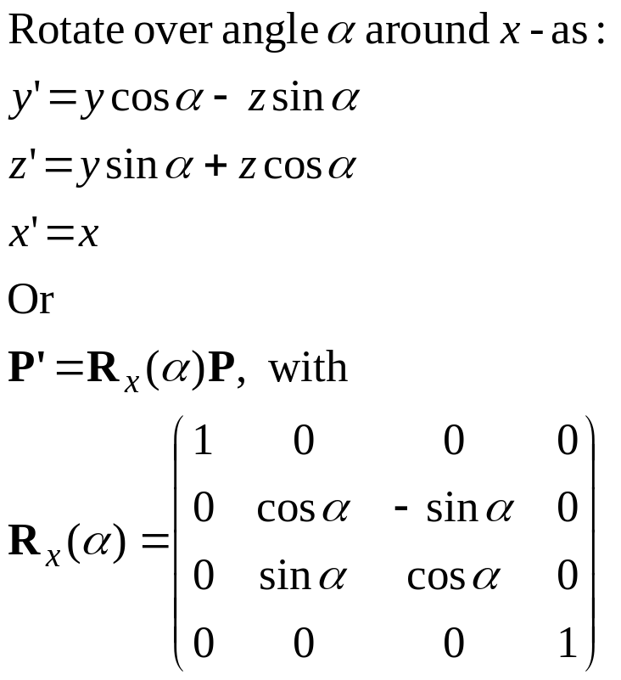
3D Rotatie 4
H&B 9-2:305-313

Slide 9
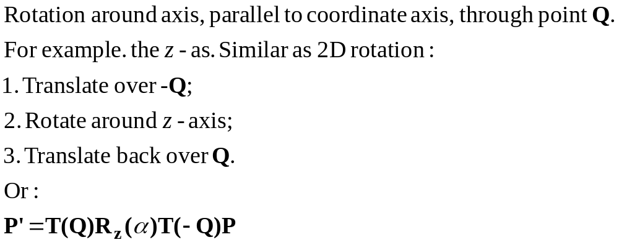
3D Rotation around arbitrary axis 1
2
3
z
P’
y
α
Q
P
1
x
H&B 9-2:305-313

Slide 10


3D Rotation around arbitrary axis 2
Rotation around axis through two points P₁ and P₁ .
More complex:
Translate such that axis goes through origin;
Rotate…
Translate back again.
y
z
x
H&B 9-2:305-313

Slide 11



3D Rotation around arbitrary axis 3
y
y
y
z
z
x
z
x
x
Initial
1. translate axis
2. rotate axis
y
y
y
z
x
z
x
z
x
3. rotate around
z-axis
4. rotate back
5. translate back

Slide 12
3D Rotation around arbitrary axis 3
y
y
y
T(−P₁)
R
z
z
x
z
x
x
Initial
1. translate axis
2. rotate axis
y
y
y
R_{z}(α)
R⁻¹
T(P₁)
z
x
z
x
z
x
3. rotate around
z-axis
4. rotate back
5. translate back

Slide 13
3D Rotation around arbitrary axis 3
M = T(P₁) R⁻¹R_{z}(α) RT(−P₁)
y
y
y
T(−P₁)
R
z
z
x
z
x
x
Initial
1. translate axis
2. rotate axis
y
y
y
R_{z}(α)
R⁻¹
T(P₁)
z
x
z
x
z
x
3. rotate around
z-axis
4. rotate back
5. translate back

Slide 14
3D Rotation around arbitrary axis 4
Difficult step:
R
y
y
2. rotate axis
z
z
x
x
Find rotation such that rotation axis aligns with z-axis.
Two options:
Step by step by step (see H&B, 309-312)
Direct derivation of matrix
H&B 9-2:305-313

Slide 15



3D Rotation around arbitrary axis 5
Construct orthonormal axis frame u, v, w;
Invent rotation matrix R, such that:
u is mapped to z-axis;
v is mapped to y-axis;
w is mapped to x-axis.
y
x
z
H&B 9-2:305-313

Slide 16
3D Rotation around arbitrary axis 6
Construct orthonormal axis frame u, v, w:
u = (P₂−P₁) / |P₂−P₁|
v = u × (1,0,0) / | u × (1,0,0) |
w = v × u
(If u = (a, 0, 0), then use (0, 1, 0))
This frame is orthonormal:
Unit length axes: u.u = v.v = w.w = 1
All axes perpendicular: u.v = v.w = w.u = 0
y
x
z
H&B 9-2:305-313

Slide 17
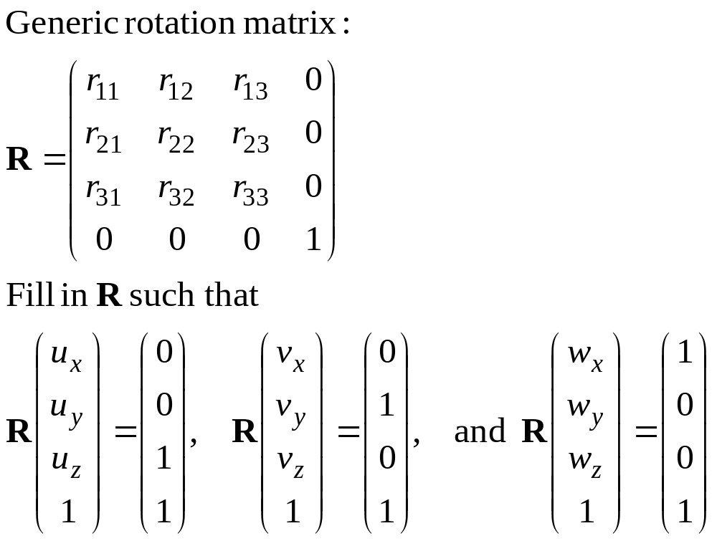
3D Rotation around arbitrary axis 7
y
x
z
H&B 9-2:305-313

Slide 18
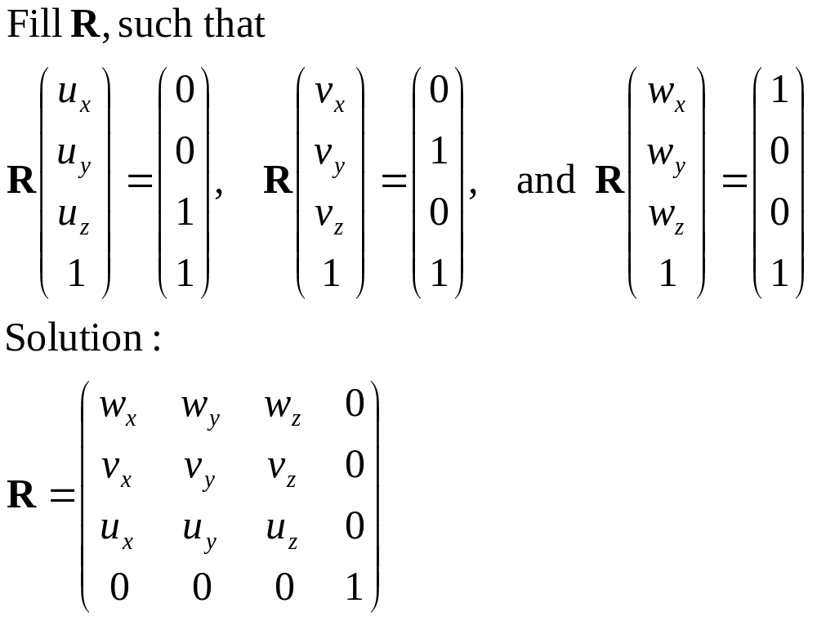
3D Rotation around arbitrary axis 8
y
x
z
H&B 9-2:305-313
Done! But how to find R⁻¹ ?

Slide 19
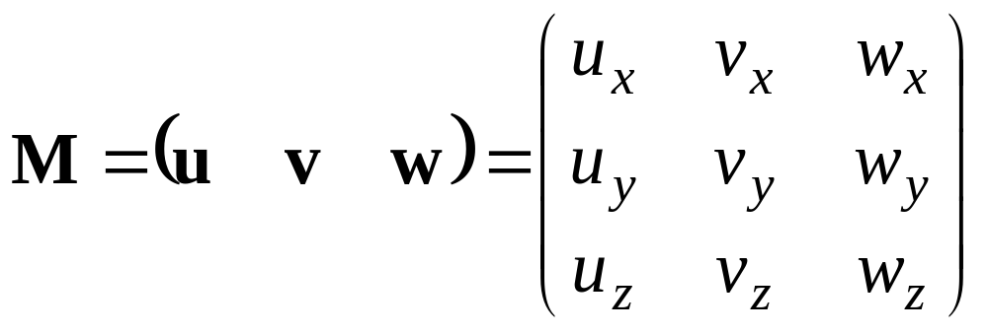
Inverse of rotation matrix 1
Each rotation matrix is an orthonormal matrix M:
The frame u, v, w is orthonormal:
Unit length axes: u.u = v.v = w.w = 1
All axes perpendicular: u.v = v.w = w.u = 0.
Requested: M⁻¹ such that M⁻¹M = I
y
x
z
H&B 9-2:305-313

Slide 20
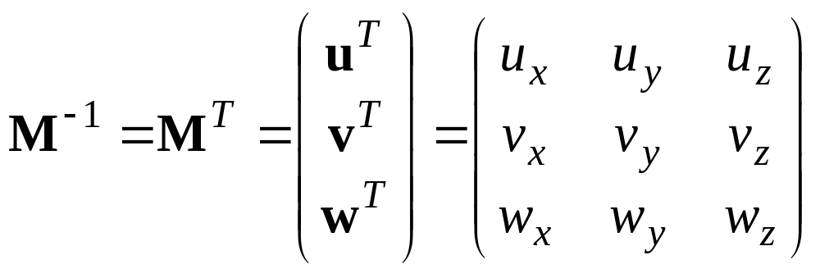
Inverse of rotation matrix 2
Requested: M⁻¹ such that M⁻¹M = I
Solution:
In words:
The inverse of a rotation matrix is the transpose.
(For a rotation around the origin).
H&B 9-2:305-313

Slide 21
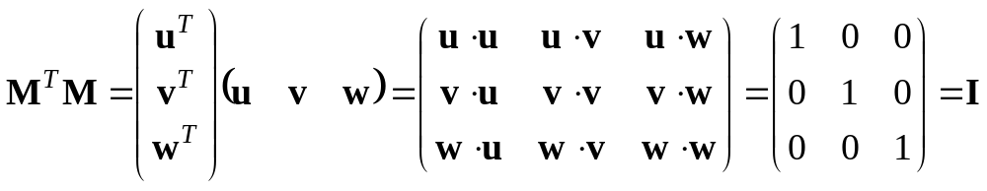
Inverse of rotation matrix 3
Requested: M⁻¹ such that M⁻¹M = I
Solution: M⁻¹ = M^{-T}
Check:
H&B 9-2:305-313

Slide 22
3D Rotation with quaternions
Quaternions:
Extension of complex numbers
Four components
Scalar value + 3D vector: q=(s,v)
Special calculation rules
Compact description of rotations
To be used if many complex rotations have
to be done (esp. animation)
H&B 9-2:313-317

Slide 23
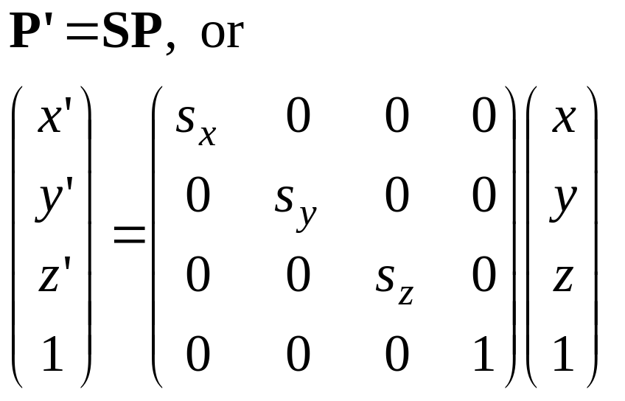
3D scaling
Scale with factors s_{x}, s_{y},s_{z} :
x’= s_{x} x, y’= s_{y} y, z’= s_{z} z
or
H&B 9-3:317-319

Slide 24
More 3D transformations
+/- same as in 2D:
Matrix concatenation by multiplication
Reflection
Shearing
Transformations between coordinate systems
H&B 9-4, 9-5, 9-6:319-324

Slide 25
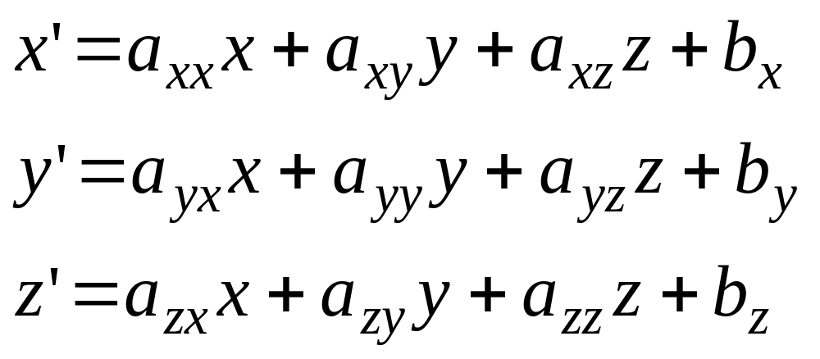
Affine transformations 1
Generic name for these transformations:
affine transformations
H&B 9-7:324

Slide 26
Affine transformations 2
Properties:
Transformed coordinates x’,y’ and z’ are linearly dependent on original coordinates x, y en z.
Parameters a_{ij} en b_{k} are constant and determine type of transformation;
Examples: translation, rotation, scaling, reflection
Parallel lines remain parallel
Only translation, rotation reflection: angles and lengths are maintained
H&B 9-7:324

